Slide 1
Unit 3 - Problem Solving by Searching
Principle of Artificial Intelligence (PAI)

Slide 2
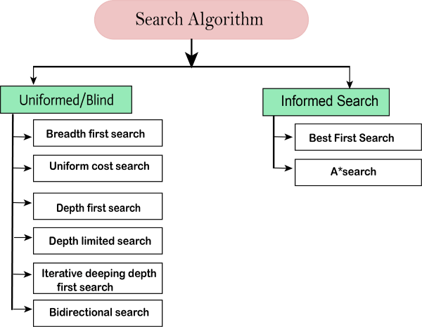
Searching Strategies

Slide 3
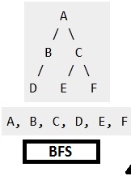
Breadth First Search (BFS)
Algorithm :
Put The Root Node on Queue.
While(Queue is not Empty)
A) Remove Node From Queue
Goal Node : Success
Put All the Child of Node in Queue.
Return Node.

Slide 4
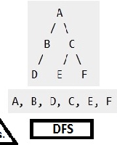
Depth First Search (DFS)
Algorithm :
Put The Root Node on Stack.
While(Stack is not Empty)
A) Pop a Node
If it a Goal Node
Push All the Child of Node in Stack
Return Failure.

Slide 5
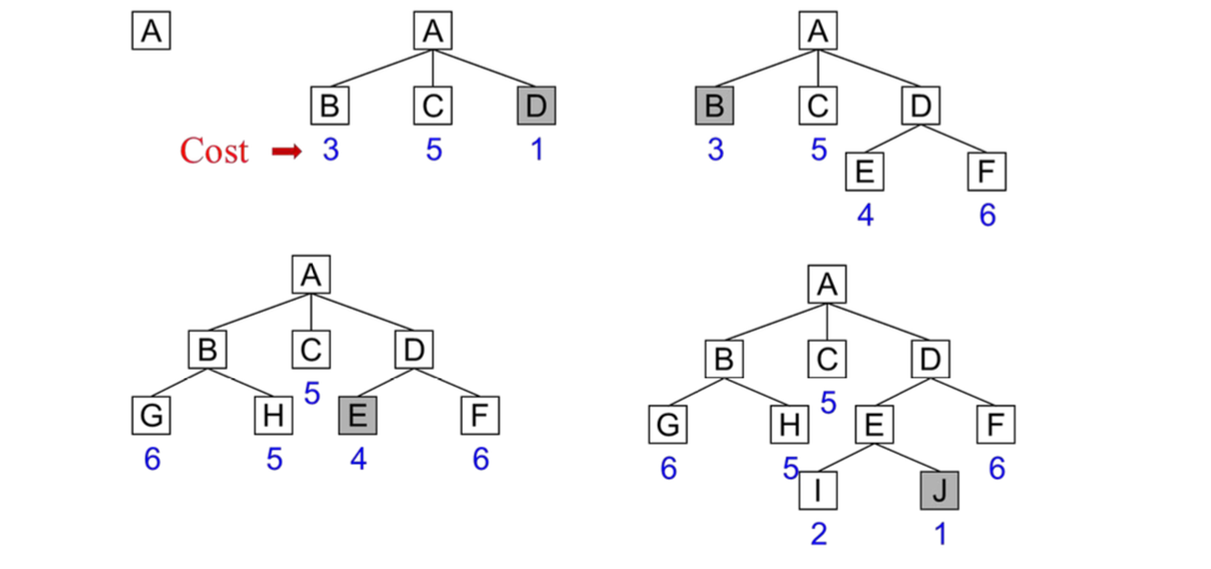
Best First Search (BFS)
Closed
D B E
Open
A D E J

Slide 6
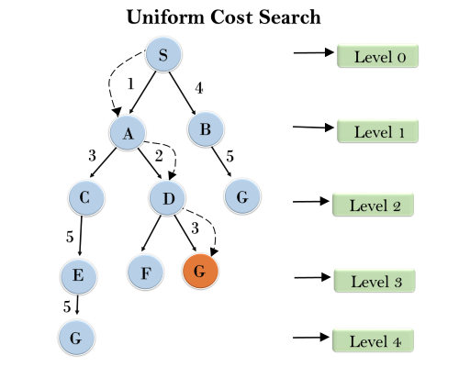
Uniform Cost Search
It’s a Searching Algorithm used for traversing a weighted tree or graph
Final Cost : S-A-D-G

Slide 7
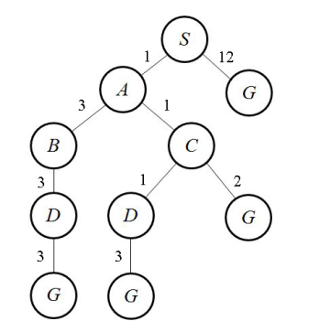
Uniform Cost Search
Final Cost : ?

Slide 8
Heuristic Search Algorithm
The Purpose of Heuristic Function is Guide the Search Process in Most Profitable Path among all other path are available.
Start State Goal State
7 | 2 | 4
5 | - | 6
8 | 3 | 1
- | 1 | 2
3 | 4 | 5
6 | 7 | 8

Slide 9
Solution : Heuristic Search Algorithm
Start State Goal State
7 | 2 | 4
5 | - | 6
8 | 3 | 1
- | 1 | 2
3 | 4 | 5
6 | 7 | 8

Slide 10
8 Puzzle Problem
Start State Goal State
1 | 2 | 3
4 | 8 | -
7 | 6 | 5
1 | 2 | 3
4 | 5 | 6
7 | 8 | -

Slide 11
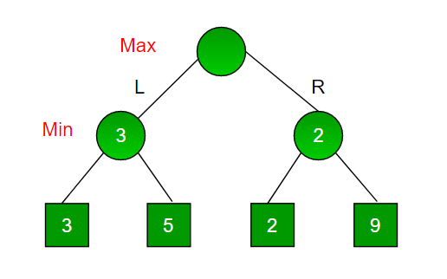
Min Max Algorithm
Its applied in Two Player Games, like Chess, Checker, Tic Tac Toe,etc.,

Slide 12
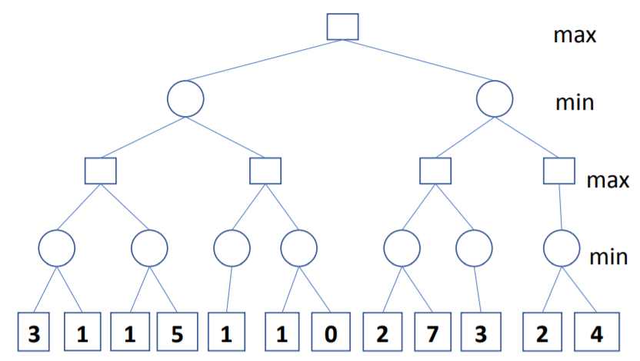
Min Max Algorithm

Slide 13
Drawbacks of Min Max Algorithm
A disadvantage of the minimax algorithm is that each board state has to be visited twice: one time to find its children and a second time to evaluate the heuristic value.
The Limitation of Min Max Algorithm can be Improved from Alpha Beta Pruning

Slide 14
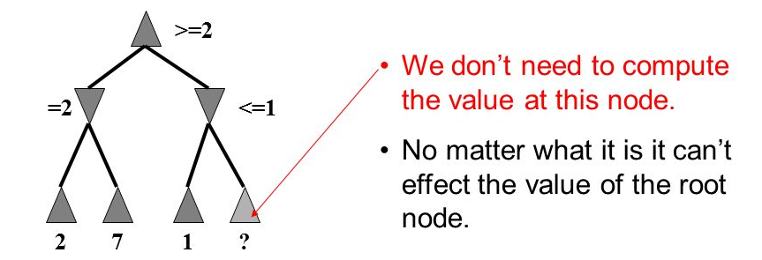
Alpha Beta Pruning
A Way to Improve the performance of Min Max Algorithm Procedure.
Basic Idea : “If You Have an idea Which is surely Bad, Don’t Take The Time to See How Truly Awful It” – Pat Winston.

Slide 15
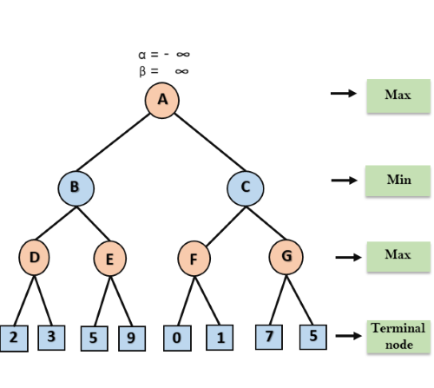
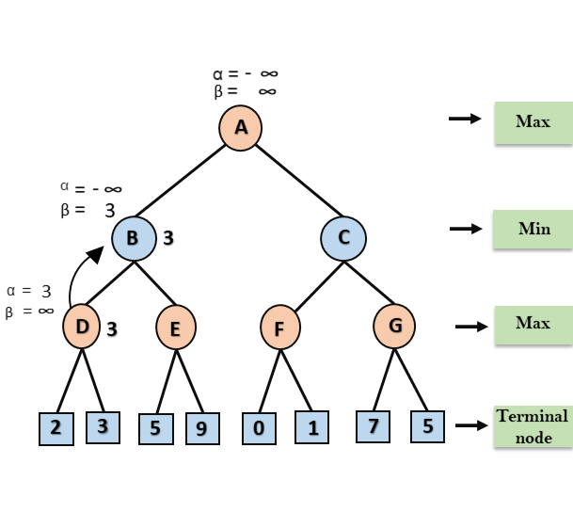
Alpha Beta Pruning

Slide 16
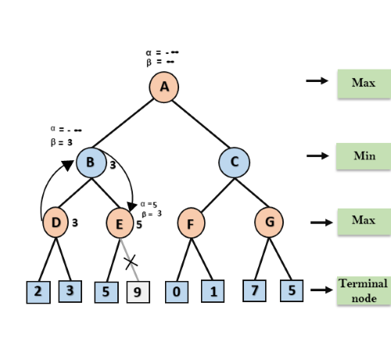
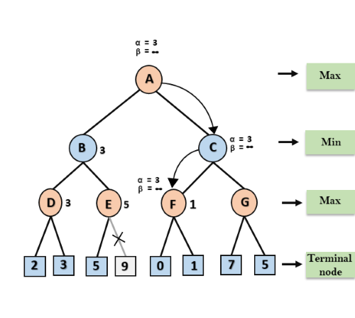
Alpha Beta Pruning

Slide 17
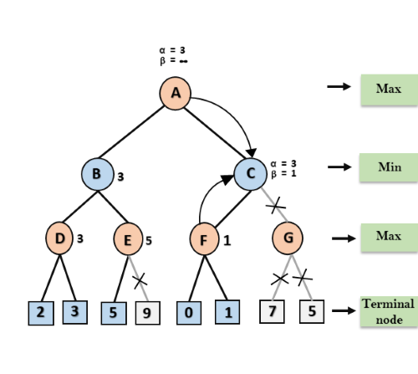
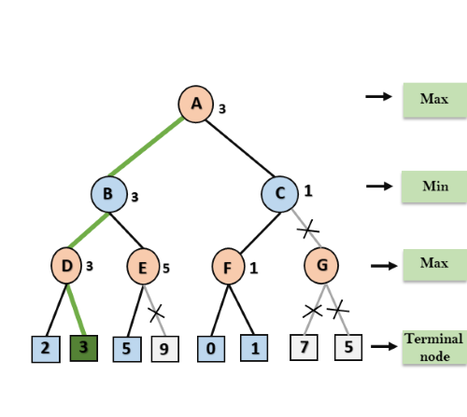
Alpha Beta Pruning

